Slide 1
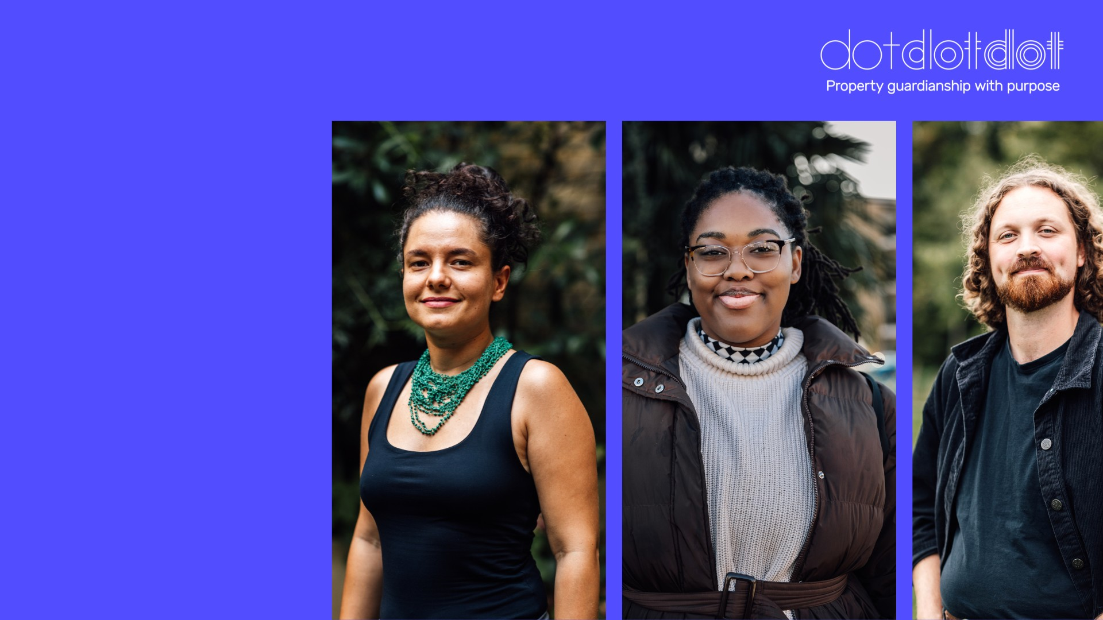
Propertyand Guardian Assistant
Job specification

Slide 2
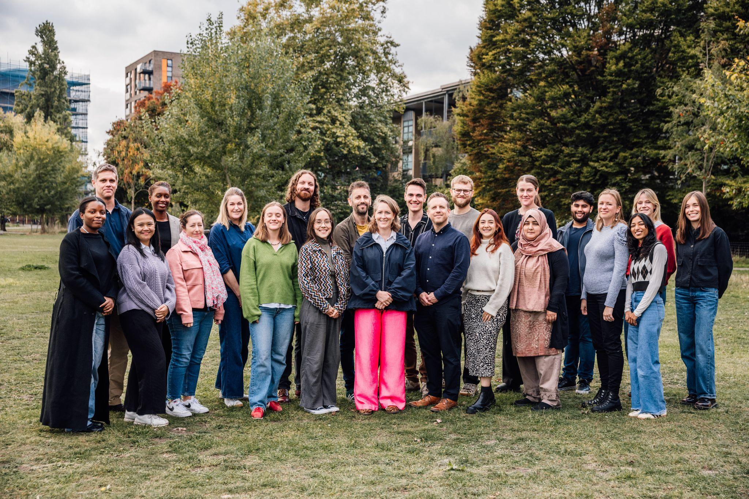

Introducing Dot Dot Dot Property
Who we are
Founded in 2011, Dot Dot Dot is a social enterprise that turns properties which would otherwise stand empty into temporary, reasonably-priced homes.
Owners benefit from cost-effective property protection. Residents - known as property guardians - gain access to inexpensive housing. Local communities are strengthened by having conscientious, engaged neighbours. Everybody wins.
Because social impact is at the heart of what we do, everyone we house commits to volunteering for good causes each month. Since 2011, we’ve housed over 2,000 people and supported them to contribute tens of thousands of hours to a wide variety of charities and community projects.
Collectively, their time has been worth £7.6 million - the equivalent of one person working full-time for more than 308 years.

Slide 3
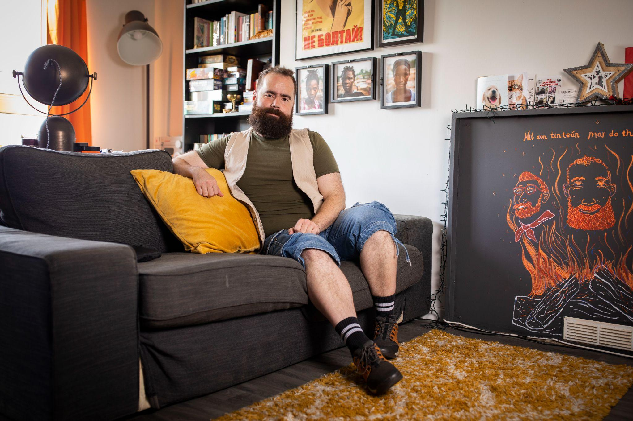
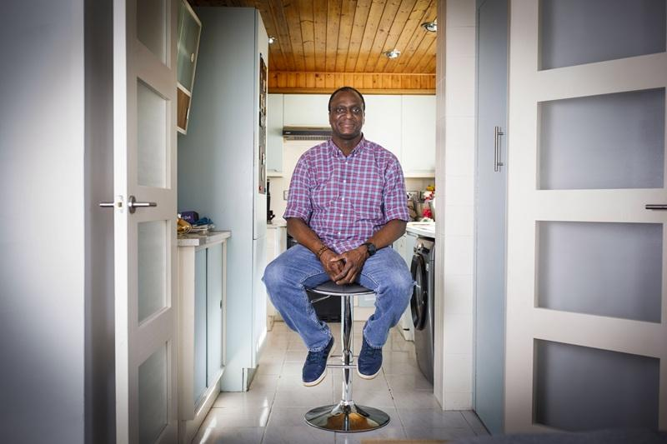
Introducing Dot Dot Dot Property
Who we work with - and who we house
We work with local councils, housing associations, charities, and trusts, giving them confidence that their buildings are safe, well cared for, and put to good use while awaiting regeneration or sale.
Current areas where we work include:
Poplar, east London
Kilburn, northwest London
Ham, Richmond
High Wycombe, Buckinghamshire
There are many reasons why someone may become a guardian with Dot Dot Dot. Some are looking to make a career change, or save up for a mortgage. Others want to make new friends and connections. Many simply need housing they can afford and which gives them time to help their community.

Slide 4
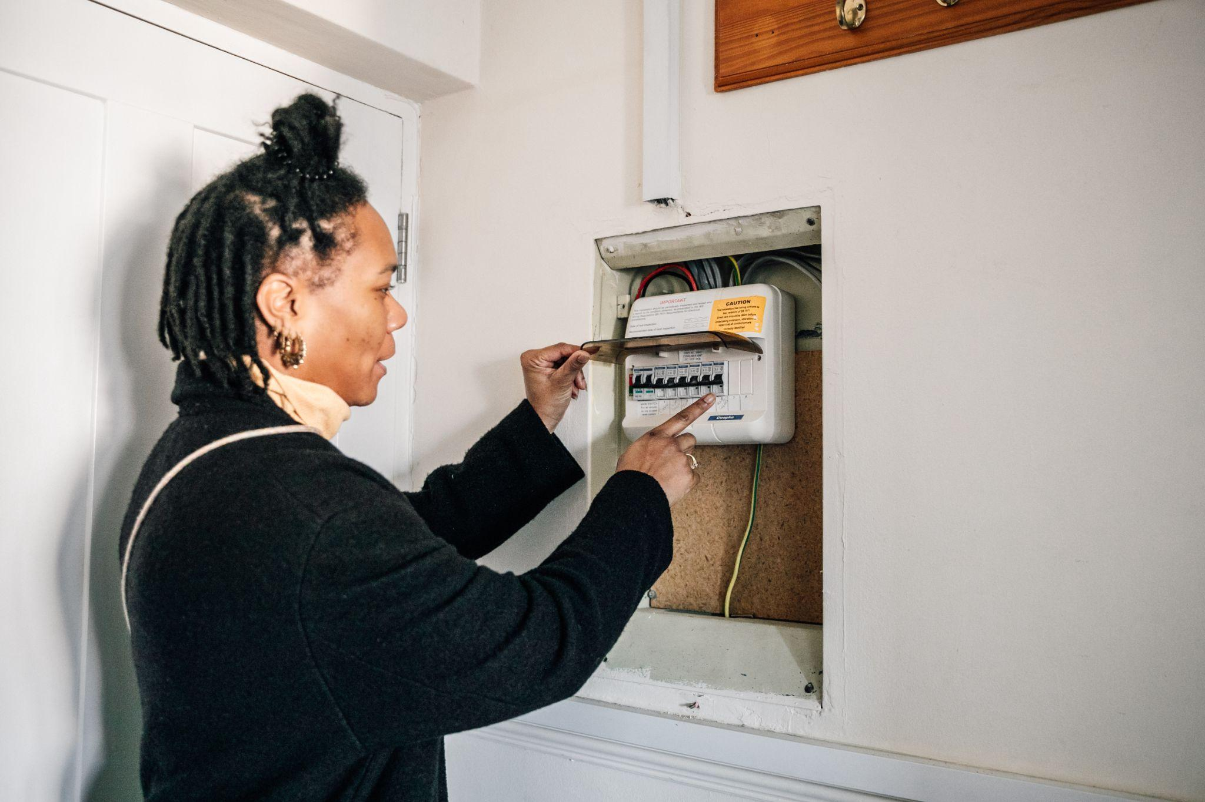
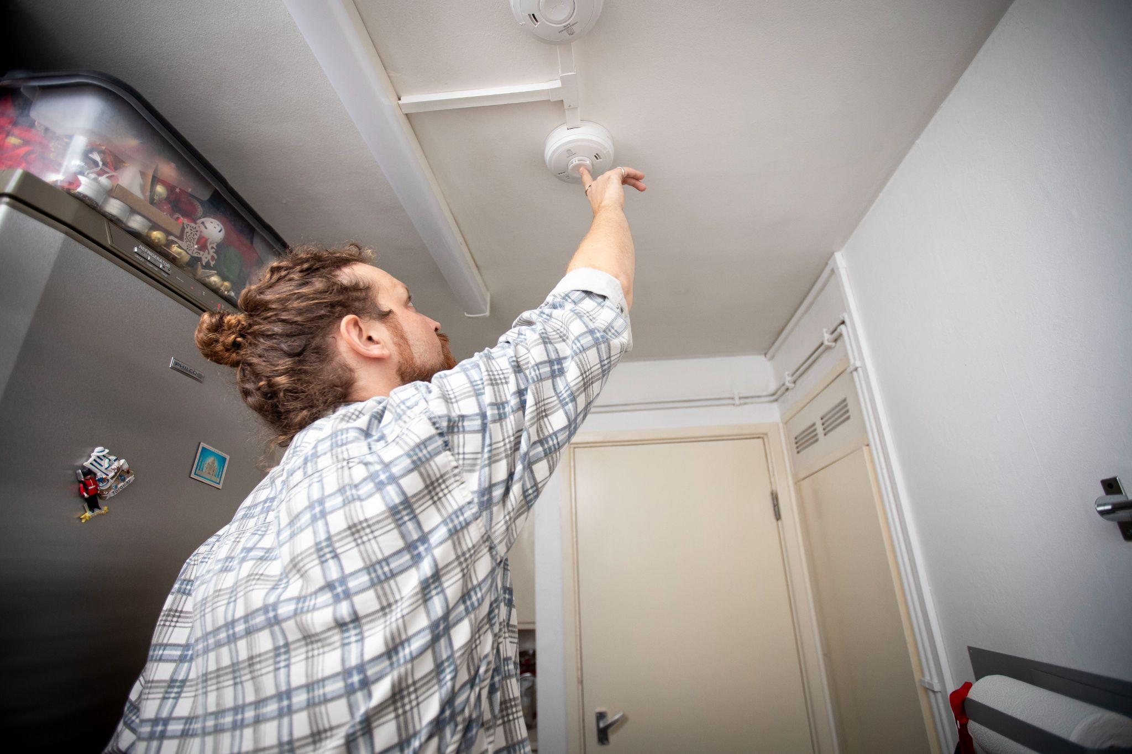
Introducing Dot Dot Dot Property
Who we are looking for
We are looking for someone to join our field team, supporting our work with a range of tasks at properties around London and throughout the UK. You might be evaluating new buildings, carrying out repairs, overseeing contractors, or inspecting occupied properties to ensure that everything is in order.
As well as the opportunity to see your work making a tangible difference, in this role you will benefit from a friendly company environment, a competitive salary, ongoing training and terms of employment which aim to support a good work-life balance.
This is a great opportunity to work flexibly for an exciting social enterprise, to use and develop hands-on skills, and help bring empty buildings back into use.

Slide 5


Property and Guardian Assistant:
the detail

Slide 6
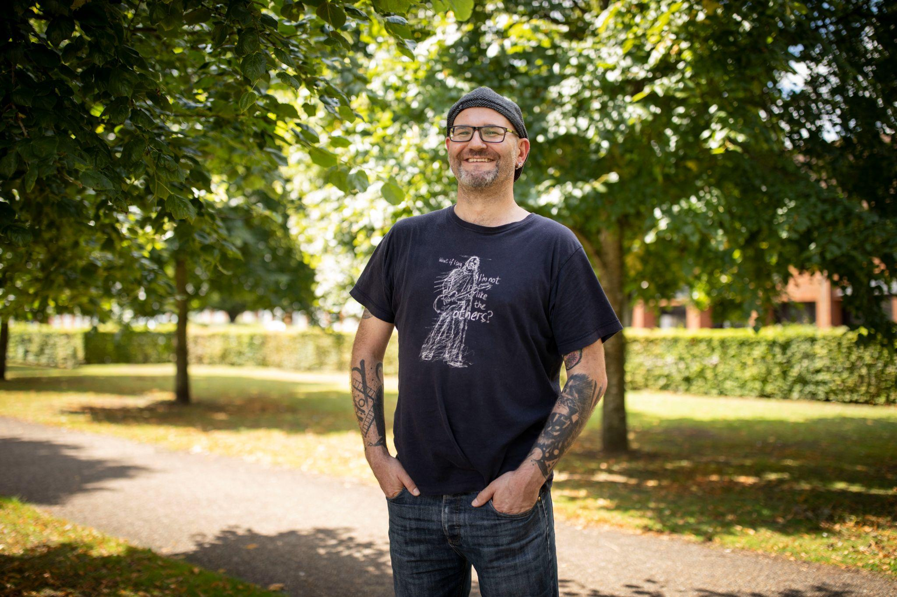

About this role
Property and Guardian Assistant
Property and Guardian Assistants are critical to our operations, allowing us to respond flexibly and effectively to the changing needs of our guardians, clients and buildings.
Known in-house as “the Squad”, they ensure that every property we manage meets our high standards. Their in-depth knowledge of our properties and priorities allows us to act quickly and decisively in an ever-changing industry.
Our Property and Guardian Assistants are the eyes, ears, and face of Dot Dot Dot on the ground. They act as ambassadors of our values and brand. They are friendly, professional, and have a genuine enthusiasm for meeting people and learning about the buildings we manage.

Slide 7
How does this role fit into Dot Dot Dot?
Your work will ensure our properties are safe, well-maintained and in line with our standards. In this role you will:
Carry out inspections to identify repair or conduct issues, reporting back and implementing solutions in consultation with the core team.
Assist with practical tasks such as reading and resetting utility meters, bleeding radiators, diagnosing issues, and carrying out minor repairs.
Facilitate access for contractors or clients as required and communicate important information to and from Dot Dot Dot’s core operational team.
Triage new properties, carrying out checks and testing to inform our mobilisation efforts.
Make final preparations ahead of guardians being housed in a property, including basic cleaning or clearance.
Assist with handbacks of properties to clients, maintaining our reputation as a reliable and high quality security provider.
Record activities, observations and issues using a range of platforms including Fastfield, Slack, Fixflo and Salesforce.
Attend Dot Dot Dot’s office for briefings and meetings and for key management processes.

Slide 8
About you
You are likely to be able to demonstrate experience of, or aptitude for, much of the following:
You care. Our mission and values as an organisation matter to you, and you are interested in the housing sector as a whole.
You roll up your sleeves. The role requires basic DIY skills, or the willingness to learn - for example, bleeding radiators, or diagnosing utility meter issues. Training will be provided for all tasks, but a can-do attitude is essential.
You are resourceful and proactive. Property and Guardian Assistants encounter new places, people and problems every day. The ability to find practical solutions or seek out advice is critical.
You come prepared and take notes. Dot Dot Dot relies on the information you relay. This is a role for someone who prepares in advance, prioritises effectively, and ensures that every detail is properly addressed and recorded.
You are a people person. Visiting occupied properties is a core part of the role. It requires confidence in and enthusiasm for meeting people, with good interpersonal skills and a friendly, professional manner.
You are tech savvy. Field work is carried out using a wide range of mobile apps, including Salesforce, Slack, Fastfield, and Peoplesafe. This is an active role, but still requires a degree of tech literacy.

Slide 9
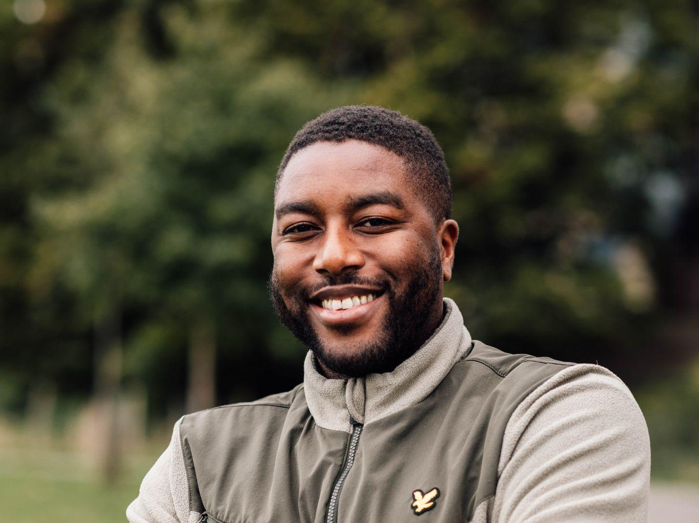
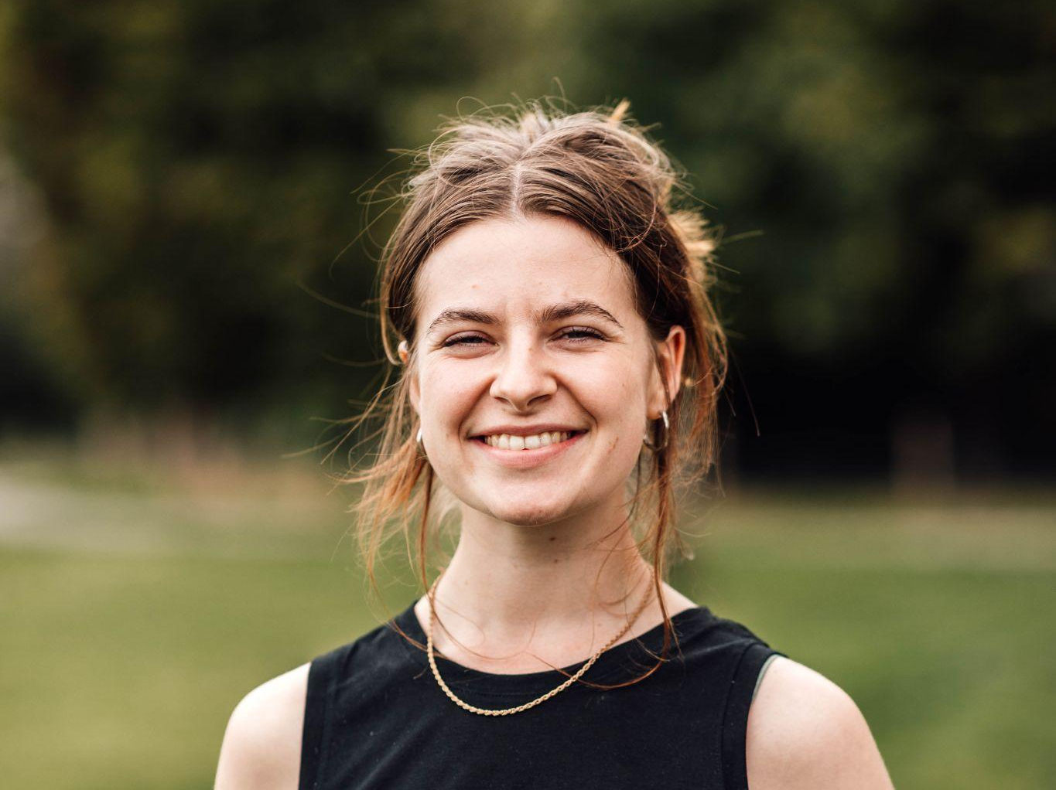
Career progression and learning opportunities
Property and Guardian Assistants are involved in many aspects of our work. This includes participating in quarterly away days, attending core meetings, and innovating to improve upon our ways of working.
All staff at Dot Dot Dot have access to a range of training opportunities such as Excel skills, Mental Health First Aid training, and First Aid at Work training, as well as ongoing safety training around fire, electricity, lone working, and more.
Members of our Field Team routinely progress into permanent roles at our head office. Alternatively, they may specialise in certain aspects of the role that best suit their skills and ambitions.
We want people in this role to learn and develop, and to feel supported in their work. We value the contribution of everyone who works with us and welcome feedback, ideas and curiosity across the organisation.
Thomas, Property & Guardian Assistant since 2021
Charlotte, now full-time Senior Service Coordinator

Slide 10
Remuneration, location and hours
Salary:
You will receive £15.74 per hour, counted “door to door”, including travel time.
Contract and hours:
Working hours are flexible and vary week to week. Schedules are typically agreed upon weekly, based on both organisational needs and worker availability.
Shifts for this role are generally full days. This may include early mornings or evenings, and very occasionally weekends. All work is based on your availability.
The contract type is a casual worker agreement. Hours are not guaranteed.
Location:
You will usually work at sites across Greater London and the south-east. At other times, you will travel to Dot Dot Dot’s office in Stratford, London E15. Training may also take place at various locations across London.
Benefits
Flexible working hours
Cycle to Work scheme
Discount on licence fees in any of our properties
Training opportunities such as Excel, First Aid, Mental Health First Aider, and a variety of workshops and online courses
Discounts on annual memberships e.g. Tate Modern and Picturehouse Cinemas
Monthly company breakfasts at head office

Slide 11

How to apply
Please apply via the online recruitment platform, Applied. The closing date for applications is Midnight on 22/02/2026.
We use the Applied recruitment platform to select the best candidates based on talent and skill and to avoid unconscious bias in our selection processes.
The first stage of the selection process is to answer the sample questions on Applied. Your answers will be reviewed anonymously by our hiring team – please note they will not see your CV at this stage so answer the questions in a way which will make sense without your CV. Shortlisted candidates will be invited to interview.
The successful candidate will be offered the role subject to satisfactory references and employment checks.
If you have questions about the role, please email Albert Grain, Property Manager at albert.grain@dotdotdotproperty.com.

